Slide 1
ORACLE SQL & JAVA PROJECT PRESENTATION
GROUP: A
Creating A School Database
System

Slide 2
CONTENT
Home page
Admin Section
Instructor Section
Student Section
Database ER Diagram

Slide 3
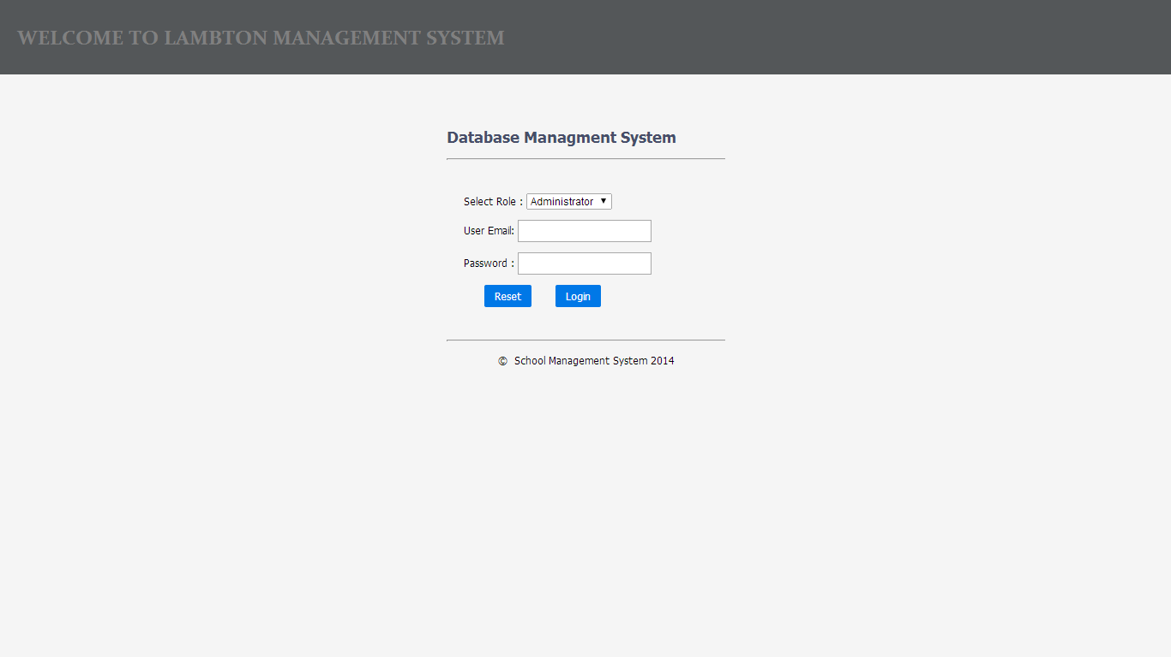
Home page section

Slide 4
Home page section
This is the home page where the user either (Administrator, Instructor and Student) will input their user-name , email and password to login

Slide 5
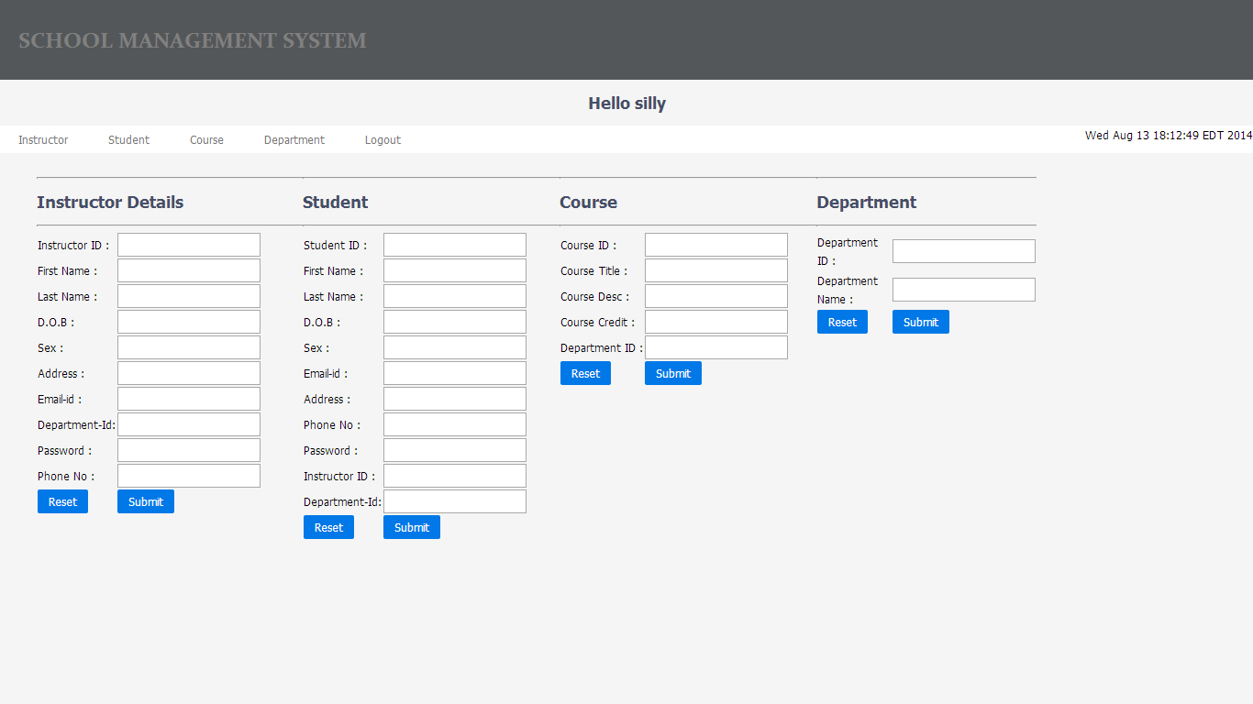
ADMIN SECTION

Slide 6
ADMIN SECTION
On this page the administrator get to Create, update and delete on the database. Also through this page the administrator has access to all the database information's of all students, instructors, departments and course.

Slide 7
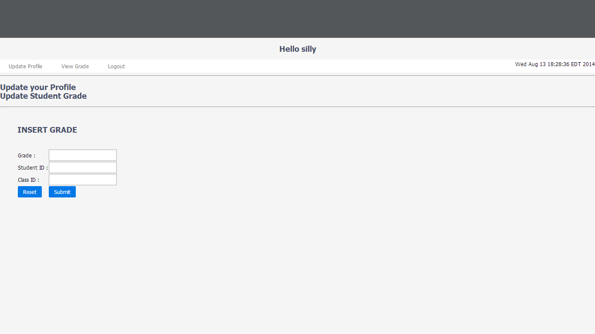
Instructor Section

Slide 8
Instructor Section
In this section only the instructor has access to this page after inputting his/her login information’s.
In this section the instructor can input his/her information's, input students grades and finally view the grades

Slide 9
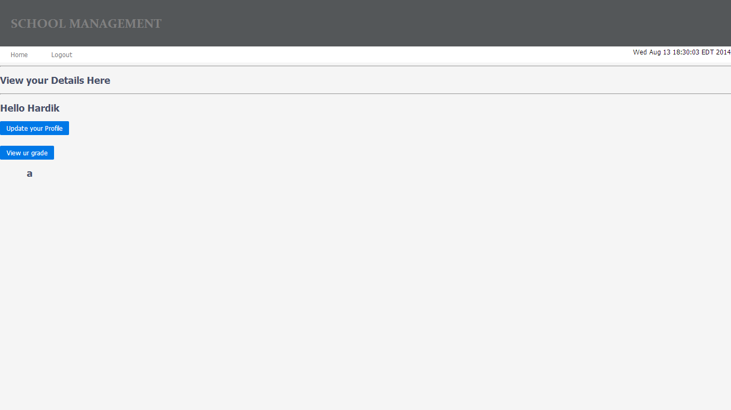
Student Section

Slide 10
Student Section
This page is only accessed by the students after logging-in.
Also the student can update their profiles and also view grades of their course.

Slide 11
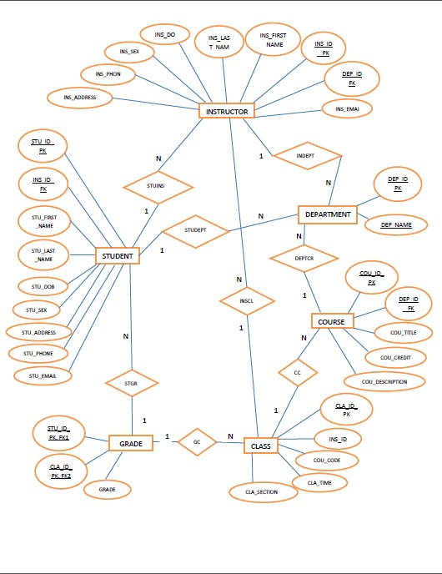
Database ER DIAGRAM

Slide 12
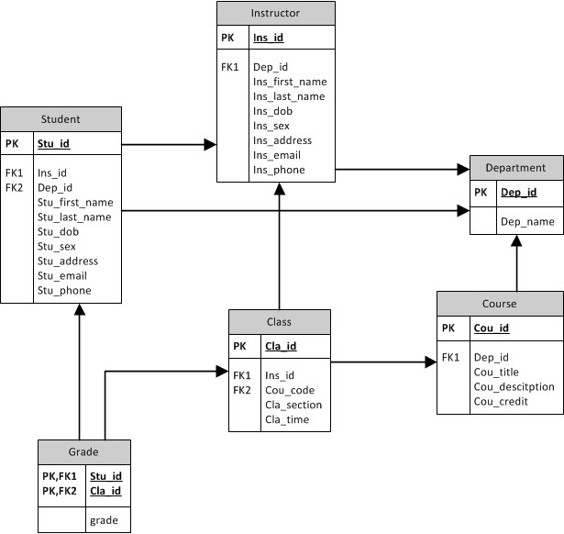
Database ER DIAGRAM

